Slide 1
Chapter 15
ASSESSMENT OF DATA MODELS
Cios / Pedrycz / Swiniarski / Kurgan

Slide 2
Outline
Introduction
Models, Their Assessment and Selection
  The Bias-Variance Dilemma
Simple Split and Cross-Validation
Bootstrap
Occam’s Razor Heuristic
Minimum Description Length Principle
Akaike’s Information Criterion and Bayesian Information Criterion
Sensitivity, Specificity and ROC Analyses
Interestingness Criteria

Slide 3
Introduction
Assessment of a data model is done by a data miner before selecting and presenting the model to the user.
The user then makes a final decision whether to accept the model in its current form, and use it for some purpose, or ask to generate a new one (a frequent outcome) .
The user’s expectation of a DM project is to find some new information/knowledge, hidden in the data, so that it can be used for some advantage.

Slide 4
Introduction
Problem:
A data miner assesses quality of the generated model often by using the same data that were used to generate the model itself (albeit divided into training and testing data sets),
while the owner/user depends not only on data and DM results but also on his deep (expert) domain knowledge.
In spite of the KDP requirement that the data miner learns about the domain and the data as much as possible,
his or her knowledge obviously constitutes only a subset of the knowledge of the experts (data owners).

Slide 5
Introduction
In practice:
A data miner generates several models of the data and must decide which one is “best” in terms of how well it explains the data and/or its predictive power, before presenting it to the data owner. We will discuss the methods for selecting “best” models.
When a data miner selects “best” model, such an undertaking is called model selection.
The data owner utilizes his domain knowledge for model assessment. Data miners attempt to do the same by coming up with artificial measures, called interestingness.
We focus mainly on the heuristic, data-reuse (data re-sampling), and analytic methods for model selection and validation.

Slide 6
Introduction
Terms model, classifier, and estimator will be used interchangeably.
A model can be defined as a description of causal relationships between input and output variables.
A classifier is a model of data used for a classification purpose: given a new input, it assigns it to one of the classes it was designed/trained to recognize.
An estimator is a method used to calculate a parameter; it is a variable defined as function of the sample values.
The number of independent pieces of information required for estimating the model is called model’s degree of freedom.

Slide 7
Introduction
One of the simplest heuristics for model selection is to choose a parsimonious model: one that uses the fewest number of parameters among several acceptably well-performing models.
There is always a model error associated with any model.
It is calculated as a difference between the observed/true value and the model output value, and is expressed either as absolute or squared error between the observed and model output values.
We can calculate model error only if training data, meaning known inputs corresponding to known outputs, are available.

Slide 8
Introduction
When we generate a model of the data, we say that we fit the model to the data.
In addition to fitting the model to the data we are also interested in using the model for prediction.
Once we have generated several models and have selected the “best” one, we need to validate it, for its goodness of fit (fit error), and its
goodness of prediction (prediction error).

Slide 9
Introduction
In NN networks and ML literature, goodness of prediction is often referred to as the generalization error. The latter term ties it into the concepts of overfitting, or underfitting, the data.
Overfitting means unnecessary increase of the model complexity. For example, increasing the number of parameters and the model degrees of freedom beyond what is necessary.
Underfitting is the opposite notion to overfitting, i.e., too simple a model will not fit the data well.

Slide 10
Introduction
We can divide model assessment techniques into groups based on the nature of the methods:
data-reuse, or re-sampling, methods
(simple split, cross-validation, bootstrap)
heuristic
(parsimonious model, Occam’s razor)
analytical
(Minimum Description Length, Aikake’s Information Criterion, and Bayesian Information Criterion)
interestingness measures

Slide 11
Bias-Variance Dilemma
Bias is defined as the error that cannot be reduced by increasing the sample size:
it is present even if an infinite sample is available
it is a systematic error.
Some sources of bias are:
- measurement error (experimental error that cannot be removed)
- sample error (sample may not be correctly drawn from the population, and thus may not represent the data correctly)
- error associated with a particular form of an estimator, etc.

Slide 12
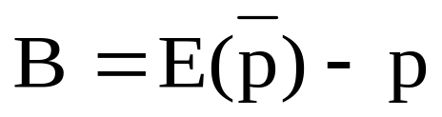
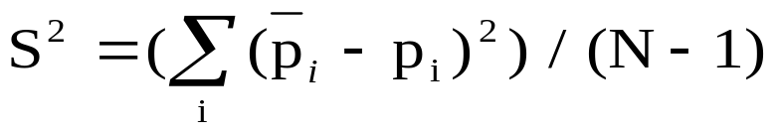
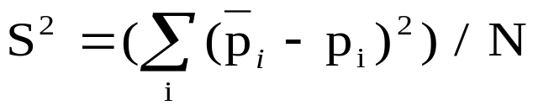
Bias-Variance Dilemma
Bias is calculated as a difference between estimated expected value and the
true value of some parameter:
Its squared value, B2, is one of the two components (the other is variance, S)
of the mean square error, MSE, which calculates the mean square difference
between a true value of a parameter, p, and its estimated value:
where the variance is:

Slide 13
Bias-Variance Dilemma
Variance is defined as an additional (to bias) error that is incurred
given a finite sample (because of sensitivity to random fluctuations).
Estimator is a method used to calculate a parameter.
Examples:
- histogram density estimator, which estimates density based on counts per interval/bin
- Bayesian estimator, which estimates the a posteriori probability from the a priori probability via Bayes’ rule.
The simplest nonparametric estimator
(meaning one that does not depend on complete knowledge of the
underlying distribution)
is the sample mean that estimates the population mean; it constitutes the simplest model of the data.

Slide 14
Bias-Variance Dilemma
Biased estimators have a non-zero bias
(meaning that the estimated expected value is different
from the true value)
while
unbiased estimators have zero bias of the estimate.

Slide 15
Bias-Variance Dilemma
There exist a trade-off between bias and
variance, known as the bias-variance dilemma.
For a given MSE, if it has large bias then it has a small
accompanying variance, and vice versa.
We are interested in finding an estimator/model which is
neither too complex (may overfit the data)
nor too simple (may underfit the data).
Such a model can be found by minimizing the MSE value, with acceptable bias and variance.

Slide 16
Bias-Variance Dilemma
Bias Variance MSE
MSE
Variance
Bias
optimal
Model complexity
Data size
Illustration of the bias -variance dilemma.

Slide 17
Bias-Variance Dilemma
A model should be chosen in such a way that does not overfit the data,
which means that it should perform acceptably well on both training and test data,
as measured by the error between the true/desired value and the actual model output value.

Slide 18
Bias-Variance Dilemma
Fit/Training &
Prediction/Test
Errors
High bias & low variance
Low bias & high variance
underfitting
Test data
Training data
overfitting
optimal
Model complexity
Data size
Choosing optimally complex model with acceptable fit and prediction errors.

Slide 19
Simple Split
Given a large data set composed of known
inputs corresponding to known outputs,
we evaluate the model by splitting the available
data into two parts:
the training part used for fitting the model,
and
the test part used for evaluation of its goodness of prediction.

Slide 20
Simple Split and Cross-Validation
If the results are unsatisfactory, then we use a
more expensive computational method, called
cross-validation, to estimate the goodness of prediction
of the model.
Informally,
we say that cross validation should be used in situations
where the data set is relatively small but difficult
(meaning that splitting into just two parts does not result
in good prediction).

Slide 21
Cross-Validation
Let n be the number of data points in the training data set. Let k be an integer index that is much smaller than n.
In a k-fold cross validation, we divide the entire data set into k equal-size subsets, and use k-1 parts for training and the remaining part for testing and calculation of the prediction error (goodness of prediction).
We repeat the procedure k number of times, and report the average from the k runs.
In an extreme situation, when data set is very small, we use n-fold cross validation which is also known as leave-one-out method.

Slide 22
Bootstrap
Bootstrap gives a nonparametric estimate of the error of a model in terms of its bias and variance.
It works as follows:
We draw x samples of equal size
from a population consisting of n samples,
with the purpose of calculating confidence intervals for
the estimates.
A strong assumption is made that the available data set of n samples constitutes the population itself.

Slide 23
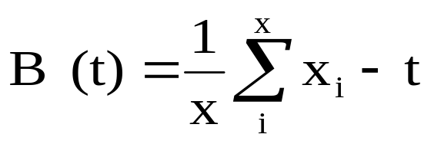
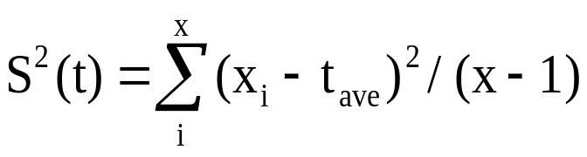
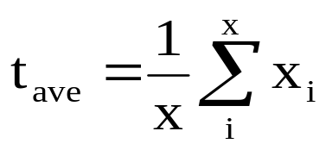
Bootstrap
First, from this “population”, x samples of size n (notice that it is the same size as the original data set),
called bootstrap samples, are drawn, with replacement.
Next, we fine-tune the existing model (originally fitted to our data of size n) to each of the x bootstrap samples. Now, we can assess the goodness of fit (error) for each of the bootstrap samples, and average it over the x samples
(let us denote by xi the ith realization of the bootstrap sample, where i=1 , …, x)
to calculate the bootstrap estimate of the bias and variance as:

Slide 24
Bootstrap
To use bootstrap for calculating goodness of prediction we treat the set of bootstrap samples as the training data set, and the original training data set as the test set.
We thus fit the model to all bootstrap samples, and calculate the prediction error on the original data.
The problem with this approach is that prediction error is too optimistic (good), since the bootstrap samples are drawn with replacement.
In other words, we calculate the prediction/generalization error on highly overlapping data (with many data items in the test set being the same as the training data). CHEATING?

Slide 25
Occam’s Razor Heuristic
Occam’s razor states that the simplest explanation (a model) of the observed phenomena, in a given domain, is the most likely to be a correct one.
Although we do not know how to determine “the simplest explanation” we intuitively agree with William of Ockham that given several models
(specified, for example, in terms of production IF… THEN… rules)
a more “compact” model
(composed of a fewer number of rules, especially if on average the rules in this model are shorter than in all other models)
should be chosen.

Slide 26
Occam’s Razor Heuristic
Occam’s razor heuristic is built-in into most machine learning algorithms, namely, that simpler/shorter/more compact description of the data is preferred over more complex ones.
Thus, another problem with this heuristic is that we want to use it for a model assessment while we have already used it for generating the model itself.
Still another issue with Occam’s razor is that some researchers say that it may be entirely incorrect, namely:
if we model some process/data known to be very complex why should a simple model of it be preferred at all?

Slide 27
Minimum Description Length Principle
Minimum Description Length (MDL) principle was designed to be general and independent of any underlying probability distribution.
Rissaneen wrote: “We never want to make a false assumption that the observed data actually were generated by a distribution of some kind, say, Gaussian, and then go on and analyze the consequences and make further deductions. Our deductions can be entertaining but quite irrelevant…”.
This statement is in stark contrast to statistical methods, because the MDL provides a clear interpretation regardless of whether some underlying “true/natural” model of data exists or not.

Slide 28
Minimum Description Length Principle
The basic idea of the MDL is connected with a specific understanding/definition of learning (model building).
Namely, MDL can be understood as finding regularities in the data, where regularity is understood as the ability to compress the data.
We say that learning can be understood as the ability to compress the data, i.e., to come up with compact description of the data (the model).

Slide 29
Minimum Description Length Principle
In parlance of machine learning, we desire to select the most general model that does not overfit the data.
In the parlance of MDL, having a set of models, M, about the data, D, we want to select the model that most compresses the data.
Both methods specify the same goal, but are stated using different language/terminology.

Slide 30
Minimum Description Length Principle
If a system can be defined in terms of input and corresponding output data, then in the worst case (longest), it can be described by supplying the entire data set, thus constituting the longest (least compressed) model of the data.
However, if regularities can be discovered in the data, say, expressed in the form of production rules, then a much shorter description is possible, and it can be measured by the MDL principle.
The MDL principle says that the complexity of a theory (model/hypothesis) is measured by the number of bits needed to encode the theory itself, plus the number of bits needed to encode the data using the theory.

Slide 31
Minimum Description Length Principle
Formally, from a set of models, we choose as the “best” the model that minimizes the following sum:
L(M) + L(D│M)
where L(M) is length (in bits) of the description of the model, and L(D│M) is length of the description of data encoded using model M.
The basic idea behind this definition can be explained using notions of underfitting and overfitting.
It is easy to find a complex model, meaning one having large L(M) value that overfits the data (i.e., with small L(D│M) value).
It is equally easy to find a simple model, with the small L(M) value that underfits the data, but which has large L(D│M) value.
Notice the similarity of the MDL principle to the bias-variance dilemma.

Slide 32
Minimum Description Length Principle
What we are looking for is a model that constitutes the best compromise between the two cases.
Suppose that we have generated two models that explain/fit the data equally well;
then the MDL principle tells us to choose one that is simpler
(for instance having the smaller number of parameters; recall that such a model is called parsimonious),
that allows for the most compact description of the data.
In that sense, the MDL can be seen as a formalization of the Occam’s razor heuristic.

Slide 33
Akaike’s Information Criterion
Akaike’s Information Criterion (AIC) and the Bayesian Information Criterion (BIC) are statistical measures used for choosing between models that use different number of parameters, d.
They are closely related to each other, as well as to the MDL.
The idea behind both is as follows. We want to estimate the prediction error, E, and use it for model selection.
What we can easily calculate is the training error, TrE. However, since the test vectors most often do not coincide with the training vectors, the TrE is often too optimistic.

Slide 34

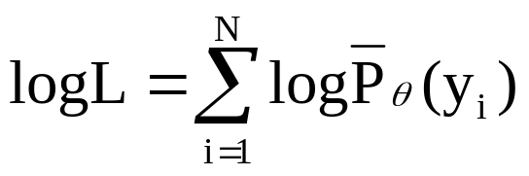
Akaike’s Information Criterion
To remedy this we estimate the error of optimism, Eop, and calculate the in-sample (given the sample) error as follows:
E = TrE + Eop
AIC is defined as:
AIC = - 2logL + 2 (d/N)
where logL is the maximized log-likelihood defined as:
P_{θ}(Y) is a family of densities containing “true” density,
is the maximum–likelihood estimate of θ, and d is the
number of parameters in the model.

Slide 35
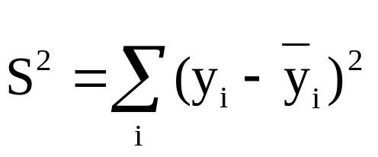
Akaike’s Information Criterion
If we have generated a family of models, which can be tuned by α (i.e. TrE(α) and d(α)) then we can rewrite AIC as:
AIC(α) = TrE(α) +2 (d(α)/N) S²
where variance S² is defined as:
The AIC(α) is an estimate of the test error curve, thus we choose as the optimal model the one that minimizes this function.

Slide 36
Bayesian Information Criterion
BIC criterion is defined as:
BIC = - 2logL + d logN
We see that AIC and BIC definitions are equivalent in the sense that 2 in the second term was replaced with logN in definition of the BIC.
For a Gaussian distribution with variance S² we can write BIC as:
BIC = (N/S²) (TrE + d/N logN)
Again, we choose the optimal model as the one corresponding to the minimum value of the BIC.
BIC favors simpler models since it heavily penalizes more complex models.

Slide 37
Sensitivity and Specificity
Let us assume that some underlying “truth”
(also known as gold standard, or hypothesis) exists,
in contrast to the MDL principle that does not require such assumption.
This means that training data is available, i.e., known inputs corresponding to known outputs.
It further implies that we know the total number of positive examples, P, and the total number of negative examples, N.
Then, we are able to form a confusion/misclassification matrix also known as contingency table.

Slide 38
Sensitivity and Specificity
 | Test | Result
Truth (Gold standard; Hypothesis) | Positive | Negative
Positive | True Positive (TP) (no error) | False Negative (FN) (Rejection error, Type I error) | P (total of true positives)
Negative | False Positive (FP) (Acceptance error, Type II error) | True Negative (TN) (no error) | N (total of true negatives)
 | Total of Test recognized as Positive | Total of Test recognized as Negative | Total population
TP is defined as the case in which the test result and gold standard (truth) are both positive; FP is the case in which the test result is positive but the gold standard is negative; TN is the case where both are negative; and FN is the case where the test result is negative but the gold standard is positive.

Slide 39
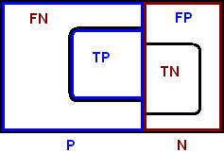
Sensitivity and Specificity
Sensitivity = TP / P = TP / (TP+FN) = Recall

Slide 40
Sensitivity and Specificity
Sensitivity measures how often we find what we are looking for (say for a certain disease).
In other words, sensitivity is 1 if all instances of the True class are classified to the True class.
What we are looking for is P = (TP+FN), i.e., all the cases in which the gold-standard (disease) is actually positive (but we found only TP of them), thus the ratio.
Sensitivity is also known in the literature under a variety of near-synonyms: TP rate, hit rate, etc. In information extraction / text mining literature it is known under the term recall.

Slide 41
Sensitivity and Specificity
Specificity = TN / N = TN / (FP+TN)

Slide 42
Sensitivity and Specificity
Specificity measures how often what we find is what we are not looking for (say, for a certain disease);
in other words, it measures the ability of a test to be negative when a disease is not present.
Specificity is 1 if only instances of True class are classified to the True class.
What we find is N= (FP+TN), i.e., all the cases in which the gold standard is actually negative (but we have found only TN of them).

Slide 43
Sensitivity and Specificity
People often report only accuracy instead of calculating both sensitivity and specificity.
The reason is that, in a situation where, say, sensitivity is high (say over 0.9) while specificity is low (say about 0.3), the accuracy may look acceptable (over 0.6 or 60%), as can be figured out from its definition:
Accuracy1 = (TP+TN) / (P+N)
Sometimes a different definition for accuracy is used, one that ignores the number of TN:
Accuracy2 = TP / (P+N)

Slide 44
Sensitivity and Specificity
In text mining a measure called precision is used:
Precision = TP / (TP + FP)
where TP + FN = P are called relevant documents and TP +FP are called retrieved documents.

Slide 45
Sensitivity and Specificity
 | Test |  | Results |  | Sum
True; Gold standard diagnosis | Classified as A | Classified as B | Classified as C | Classified as D
A | 4 | 1 | 1 | 1 | 7
B | 0 | 7 | 0 | 0 | 7
C | 0 | 0 | 2 | 1 | 3
D | 0 | 0 | 0 | 10 | 10
Sum | 4 | 8 | 3 | 12 | 27

Slide 46
Sensitivity and Specificity
 | Class A | Class B | Class C | Class D
Sensitivity | .57 (4/7) | 1.0 (7/7) | .67 (2/3) | 1.0 (10/10)
Specificity | 1.0 (20/20) | .95 (19/20) | .96 (23/24) | .88 (15/17)
Accuracy | .89 (4+20)/27 | .96 (7+19)/27 | .93 (2+23)/27 | .93 (10+15)/27

Slide 47
Sensitivity and Specificity
Class A | Test result positive (A) | Test result negative (N or U)
positive rules (for A) | 13 | 0 + 2 = 2
negative rules (for N) | 3 | 5 + 1 = 6
Sensitivity = TP / (TP+FN) = 13/(13+2) = .867
Specificity = TN / (FP+TN) = 6/(3+6) = .667
Accuracy = (TP+TN) / (TP+TN+FP+FN) = (13+6) / (13+2+3+6) = .792

Slide 48
Sensitivity and Specificity
Class N | Test result positive (N) | Test result negative (A or U)
negative rules (for N) | 5 | 3 + 1 = 4
positive rules (for A) | 0 | 13 + 2 = 15
Sensitivity = TP / (TP+FN) = 5/(5+4) = .556
Specificity = TN / (FP+TN) = 15/(15+0) = 1.0
Accuracy = (TP+TN) / (TP+TN+FP+FN) = (5+15) / (5+4+15+0) = .883

Slide 49
Sensitivity and Specificity
Results for class | Sensitivity | Specificity | Accuracy
A | .867 | .667 | .792
N | .556 | 1.0 | .833
MEAN | .712 | .834 | .813

Slide 50
Sensitivity and Specificity
Other measures can be calculated from the confusion matrix:
False Discovery Rate (FDR) = FP / (TP + FP)

Slide 51
Sensitivity and Specificity
F-measure is calculated as the harmonic mean of recall/sensitivity and precision:
F-measure = (2 x Precision x Recall) / (Precision + Recall)

Slide 52
ROC Analyses
Receiver Operating Characteristics (ROC) analysis is performed by drawing curves in two-dimensional space, with axes defined by the TP rate and FP rate, or equivalently, by using terms of sensitivity and specificity.
Let us define the FP rate as being equal to FP/N similarly (but using “negative” logic) to the TP rate
(that is equal to TP/P, and which is better known under the term sensitivity),
then we can re-write the specificity as
Specificity = 1 - FP rate
from which we obtain
FP rate = 1- Specificity

Slide 53
ROC Analyses
Sensitivity = TP rate
(1,1)
1
. P
W
.5
(0,0)
.5
1
1-Specificity= FP rate
A ROC graph.

Slide 54
ROC Analyses
ROC plots allow for visual comparison of several models (classifiers).
For each model, we calculate its sensitivity and specificity, and draw it as a point on the ROC graph.
Confusion matrix represents the evaluation of a model/classifier, which when drawn on the ROC graph, represents a single point, corresponding to a (1-specificity, sensitivity) value, denoted as point P.
The ideal model/classifier would be one represented by a location (0,1) on the graph, corresponding to 100% specificity and 100% sensitivity.

Slide 55
ROC Analyses
Points (0,0) and (1,1) represent 100% specificity and 0% sensitivity for the first point, and 0% specificity and 100% sensitivity for the second, respectively.
Neither of the two points would represent an acceptable model to a data miner. All points lying on the curve connecting the two points ((0,0) and (1,1)) represent random guessing of the classes (equal values of 1-specificity and sensitivity, or in other words, equal values of TP and FP rates.
That means that these models/classifiers would recognize equal amounts of TP and FP, with the point W at (0.5, 0.5) representing 50% specificity and 50% sensitivity.
These observations suggests the strategy for always “operating” in the region above the diagonal line (y=x), since in this region the TP rate is higher than the FP rate.

Slide 56
ROC Analyses
How can we obtain a curve on the ROC plot corresponding to a classifier, say A?
To explain, let us assume that for a (large) class called Abnormal (say one representing people with some disease) we have drawn a distribution of the examples over some symptom (feature/attribute).
And let us assume that we have done the same for (large) class Normal (say representing Normal (people without a disease) over the same symptom.
Quite often the two distributions overlap.

Slide 57
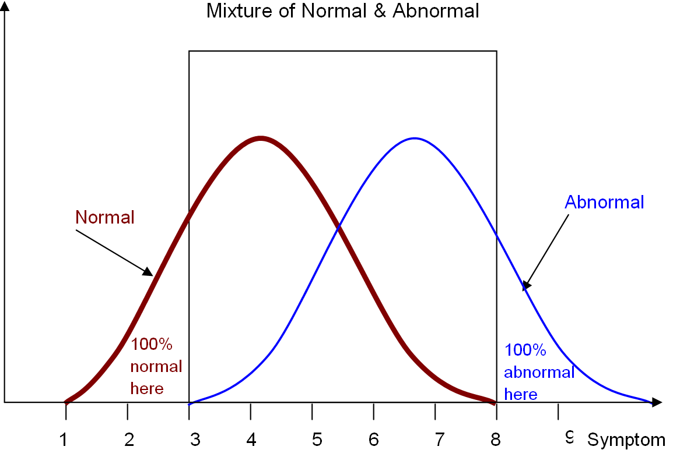
ROC Analyses
Distribution of Normal (healthy) Abnormal (sick) patients.

Slide 58
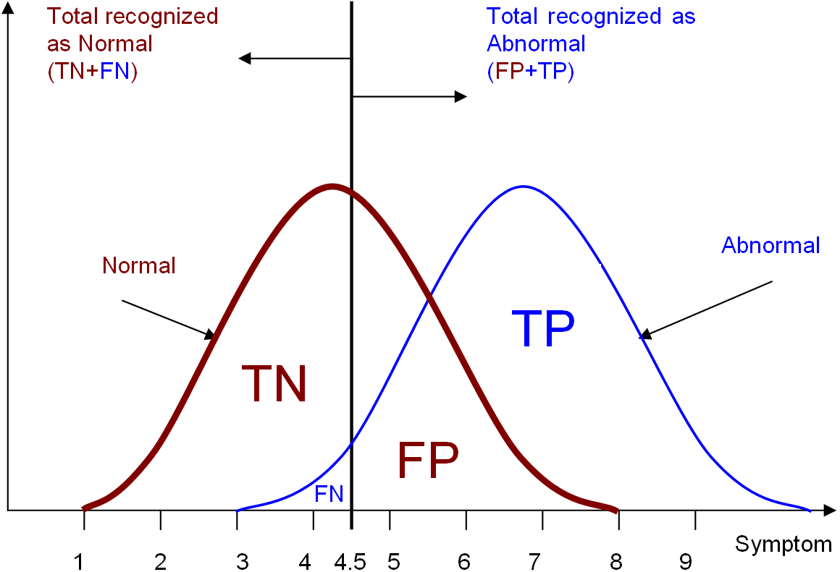
ROC Analyses
Division into Normal and Abnormal patients using a threshold of 4.5.

Slide 59
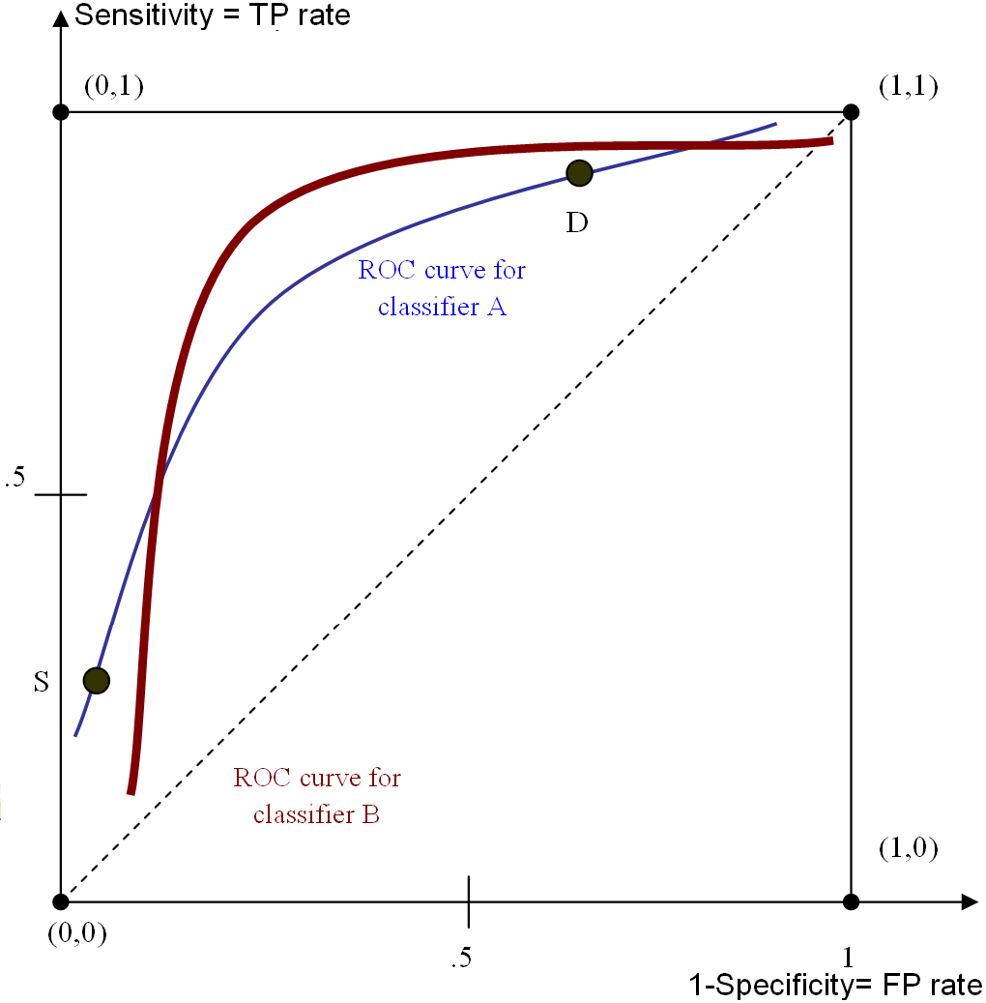
ROC Analyses
ROC curves for two classifiers: A and B

Slide 60
ROC Analyses
How to decide which of the two classifiers constitutes a better model/classifier of the data?
We could perform visual analysis: the curve more to the upper left would indicate a better classifier. However, the curves often overlap, and a decision may not be so easy to make.
A popular method used to solve the problem is called Area Under Curve (AUC).
The area under the diagonal curve is 0.5. Thus, we are interested in choosing a model/classifier which has maximum area under its corresponding ROC curve: the larger the area the better performing the model/classifier is.
There exist a measure similar to the AUC for assessing the goodness of a model/classifier, known as Gini coefficient, which is defined as twice the area between the diagonal and the ROC curve; the two measures are equivalent since
Gini + 1 = 2 AUC

Slide 61
Interestingness Measures
Similarly to research carried out in the area of expert systems, when the computer scientists mimicked human decision-making processes by interviewing experts and codifying the rules they use (e.g., how to diagnose a patient) in terms of production rules,
data miners undertook similar effort to formalize the measures (supposedly) used by domain experts/data owners to evaluate models of data.
Such criteria can be roughly divided into those assessing interestingness of the association rules generated from unsupervised data, and those for assessing interestingness of rules generated by inductive machine learning (i.e. decision trees/production rules) from supervised data.

Slide 62
Interestingness Measures
Rule refinement is used to reduce number of rules and focus only on some more important (according to some criterion) rules.
First, we identify potentially interesting rules, namely, those that satisfy user-specified criteria like strengths of the rules, their complexity etc., or that are similar to the rules that already satisfy such criteria.
Second, a subset of theses rules, called technically interesting rules (the name arises from using at this stage more formal methods like chi-square, AIC, BIC, etc.).
In the third step we remove all but the technically interesting rules. Notice, that the just described process of rule refinement is “equivalent” to selection of the “best” rules done by the end user.

Slide 63
Interestingness Measures
Interestingness measure is used to assess interestingness of generated classification rules, one rule at a time.
Classification rules are divided into two types:
discriminant rules (when evidence, “e”, implies hypothesis, “h”; a rule specifies conditions sufficient for distinguishing between classes; such rules are the most frequently used in practice), and
characteristic rules (when hypothesis implies evidence; a rule specifies conditions necessary for membership in a class).
To assess interestingness of a characteristic rule, we first use measures of sufficiency and necessity.

Slide 64
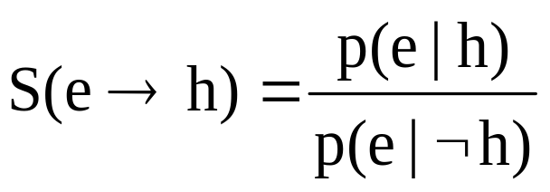
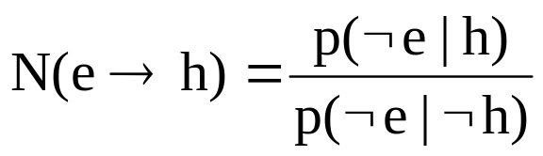
Interestingness Measures
where → stand for implication and the ¬ symbol stands for negation. These two measures are used for determining interestingness of different forms of characteristic rules by using the following relations:

Slide 65
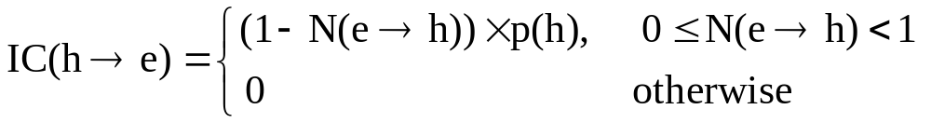
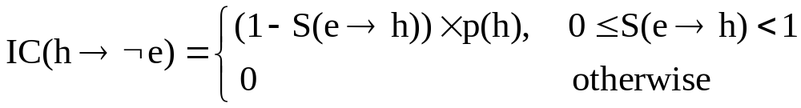
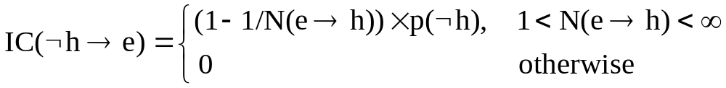
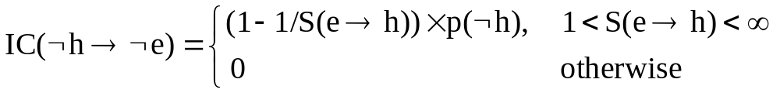
Interestingness Measures
The calculated values of interestingness are in the range from 0 (min) to 1 (max),
and the owner of the data needs to use some threshold (say, .5) to make a decision
of retaining or removing the rules.

Slide 66
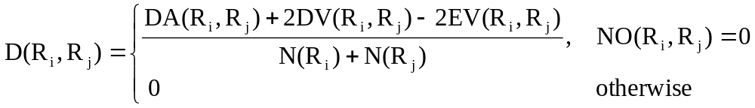
Interestingness Measures
Distance is another criterion that measures distance between two of the generated rules at a time, to find the strongest (with highest coverage) rules. It is defined by:
where Ri and Rj are rules; DA(Ri, Rj) is the sum of the number of attributes present in Ri but not in Rj , and the sum of attributes present in Rj but not in Ri;
DV(Ri, Rj) is the number of attributes in Ri and Rj that have slightly (less than 2/3 of the range) overlapping values;
EV(Ri, Rj) is the number of attributes in both rules that have overlapping (more than 2/3) values in the range;
N(Ri) and N(Rj) are the number of attributes in each rule, and
NO(Ri, Rj) is the number of attributes in Ri and Rj with nonoverlapping values.

Slide 67
Interestingness Measures
The distance criterion calculates values in the range from -1 to 1, indicating strong and slight overlap, respectively.
The value of 1 means no overlap.
The most interesting rules are those with the highest average distance to the other rules.

Slide 68
References
Cios, K.J., Pedrycz, W. and Swiniarski, R. 1998. Data Mining Methods for Knowledge Discovery. Kluwer
Grunwald PD, Myung I.J and Pitt MA (eds.). 2005. Advances in Minimum Description Length Theory and Applications. MIT Press
Hastie T, Tibshirani R and Friedman J. 2001. The Elements of Statistical Learning: Data Mining, Inference and Prediction. Springer
Hilderman RJ and Hamilton HJ. 1999. Knowledge Discovery and Interestingness Measures: A Survey. Technical Report CS 99-04, University of Regina, Regina, Saskatchewan, Canada
Moore GW and Hutchins GM. 1983. Consistency versus completeness in medical decision-making: Exemplar of 155 patients autopsied after coronary artery bypass graft surgery. Med Inform (London). Jul-Sep., 8(3):197-207
Kecman V. 2001. Learning and Soft Computing. MIT Press
Rissaneen J. 1989. Stochastic Complexity in Statistical Inquiry. World Scientific

